Slide 1
MY HOBBY IS SINGING AND LISTENING TO
NHÓM 1
MUSIC

Slide 2
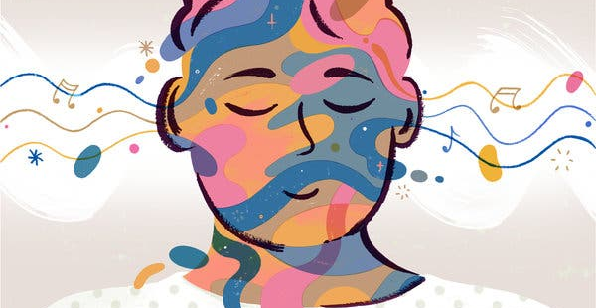

The effect of music in life
- Entertainment, the formation, human development
- Effective aspect to educate people comprehensively - A source of happiness for everyone Enhance memory, study and work efficiency - "Music is the echo of emotions.“ - Has a good effect on health

Slide 3
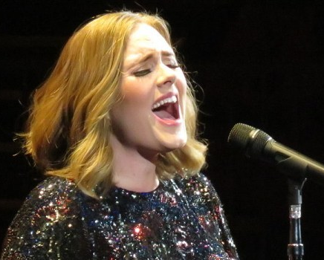
MY FAVORITE singers
I have a lot of idols and they are really awsome. And now I will tell you how great they are

Slide 4
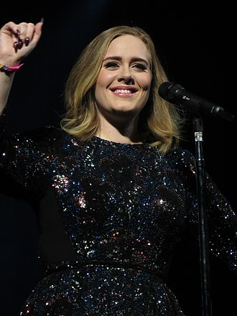
ADELE
Real Name: Adele Laurie Blue Adkins
Born: May 5, 1988
Place of birth: Tottenham, London, England
Work: Singer who writes songs
Genre: Soul pop blue-eyed soul R&B
Musical instruments: Guitar vocal piano bass
Year of operation: 2006 – present She won many prestigious awards such as Grammy, Academy Awards, Billboard Music Awards, ...

Slide 5
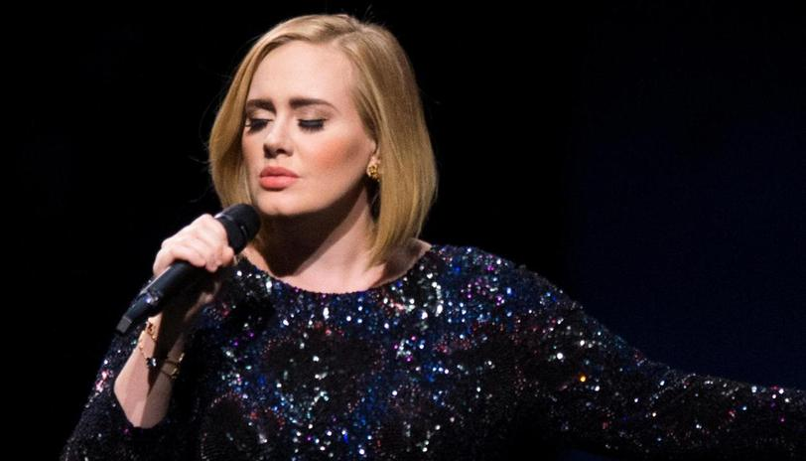

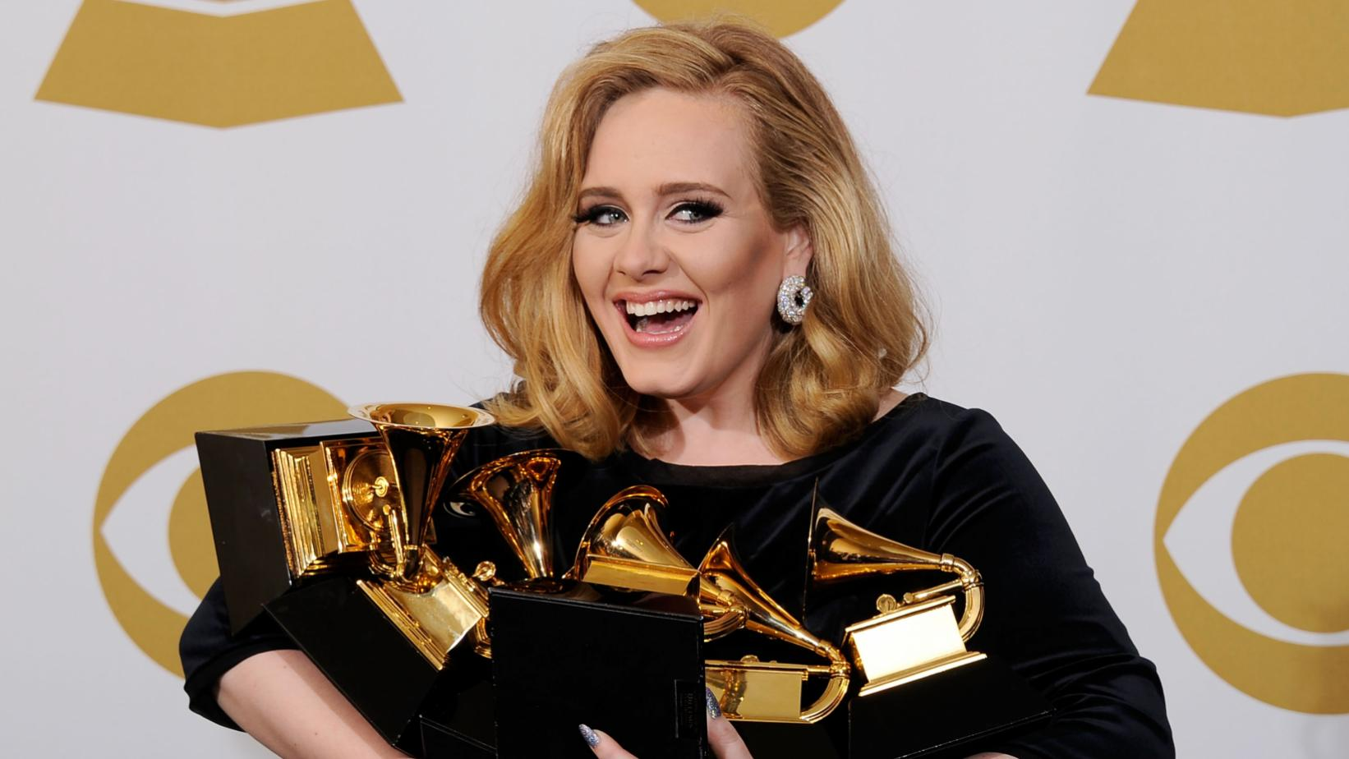
ADDITIONAL PICTURE

Slide 6

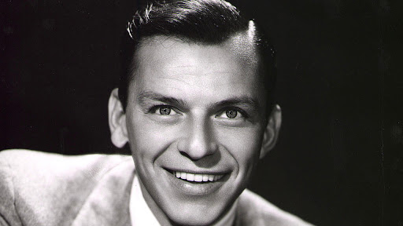
FRANK SINATRA
- Real name: Francis Albert Sinatra - Born : 12/12/1915 - Dead : 14/5/1998 - Genre : Pop, Jazz, Swing - Work : Singer, Actor, Producer
One of the great singers of America

Slide 7
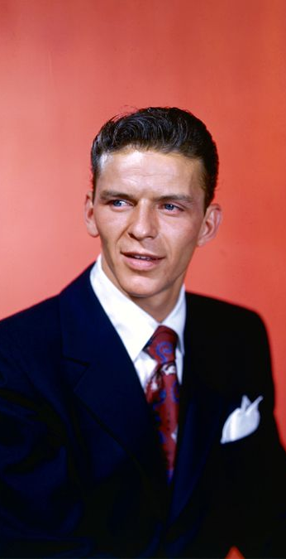
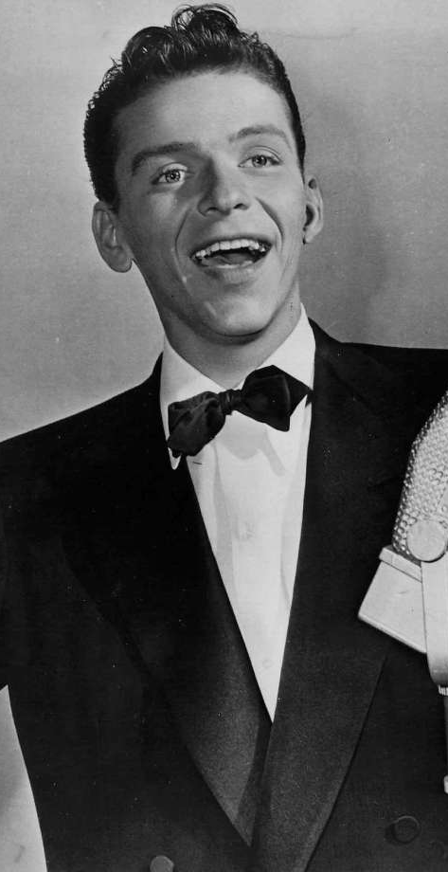
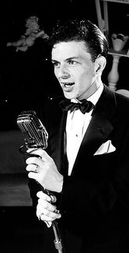
career
- MOVIE : “From Here to Eternity”, “Pal Joey”, “Guys and Dolls”, “On the Town”, “Eleven Ocean,“ “The Manchurian Candidate” - SONG : That’s Life, Fly Me To The Moon, I’m A Fool To Want You, One For My baby,…

Slide 8
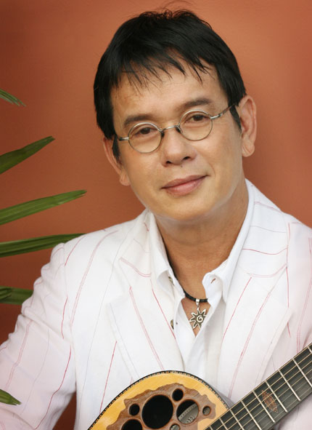
ĐỨC Huy
- Real name: Đặng Đức Huy - Born : 10/6/1947 - Genre : lyrical music, Pop, Ballad He has many songs loved by Vietnamese audiences, considered to be one of the representative musicians of overseas music.

Slide 9
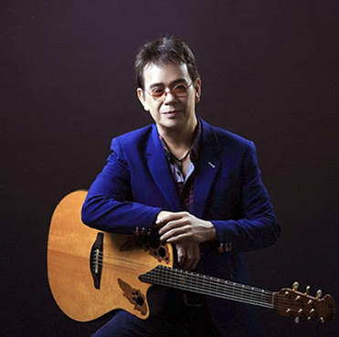
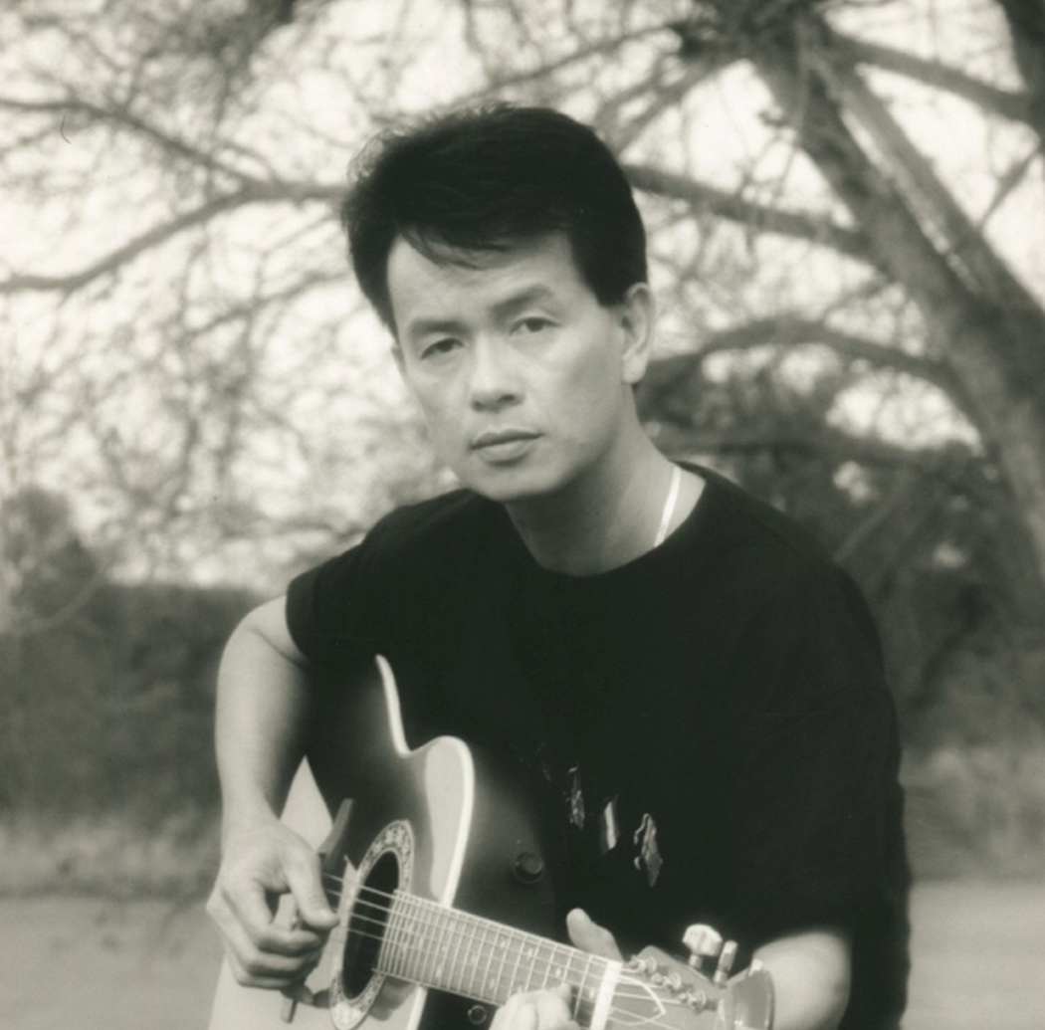
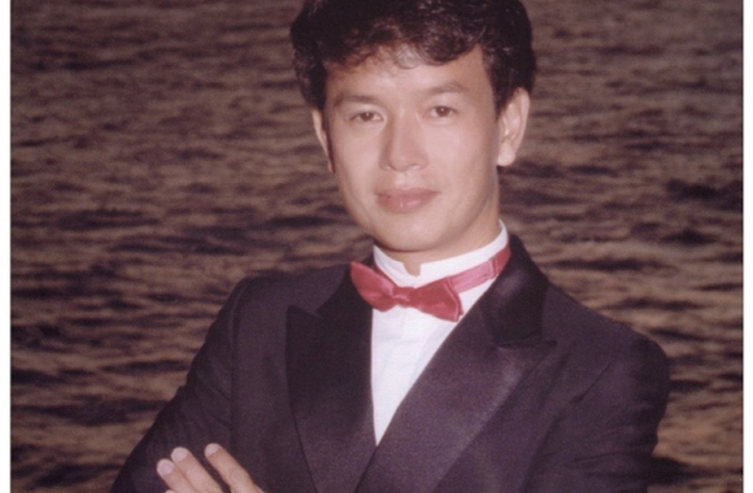
FEATURED SONGS
Đừng xa em đêm nay
Đường xa ướt mưa
Lời yêu thưương
Một tình yêu
Nếu xa nhau (…)

Slide 10
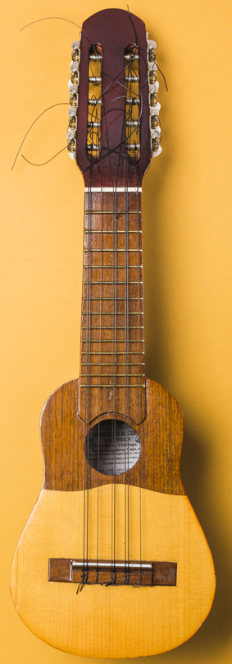
guess the name of the song
It’s time for a game

Slide 11

Thank you for your attention !

